Slide 1



Design
Thinking
E-Workbook
For Entrepreneurship Development (2HS309) Course

Slide 2


Instructions
This workbook is for INTERNAL USE ONLY for Entrepreneurship Development course (2HS309) at Ganpat University and INTELLECTUAL PROPERTY of Innodesk Designovation Services.
Students may take a screenshot (clearly visible) of the activities, tools and framework for each stage, paste it on word or ppt file and add their project related data and inputs for submission.
After completing all exercises and assignments, upload your workbook with all details and photographs of your project for continuous evaluation as per schedule/deadline.

Slide 3
Design Thinking Project (20 marks)
Team Formation:
Group of 6-8 (Min. 5 – Max. 8)
Domain Selection:
Select an organization/location/scenario/area of your interest
You may also select START-UP idea

Slide 4
INNODESK Design Thinking:
Modes/Phases
Problem Zone
Observation
Empathy
Ideation
Product Development
Test
Prototype
(Follow this process)
Human Centric Approach
Solution Zone
© 2015 Karmjitsinh Bihola. All rights reserved.

Slide 5
To Empathize, one need to have Observation, Immersion, Engagement again and again.
EMPATHIZE
OBSERVE IMMERSE ENGAGE
Observing users’ action and hypothesizing why they are acting a certain way
Generate the questions like – What, Why, When, Where, How…..
Become the user and live their experience by Role Playing
Shadowing user
Camera study
Interacting with User/Industry people about their products, processes and all related queries
Visual & Verbal
Formal & Informal Interviews
Traits of Empathetic Person:
Curious, Respect, Observance, Good Listener, Intuition, Emotional Intelligence, Presence of Mind, Open Minded, Kind
© 2020 Innodesk Designovation Services. All rights reserved.

Slide 6
Research Plan: Create a Design Research plan which will help you to find Problems &/or Possibilities when you are on the fields, Kindly keep in mind below aspects,
Where to look for – Select time, place and stakeholders to study
What to observe & learn – Capturing individual data points and insights, what information are you looking for, data to understand needs and pains of people
How to look for it – List of Tools & Techniques
Roles of your team – What are different roles of your team members (Observer, Interviewer, Note taker, photos & videos taking etc.)
Listen carefully to understand different viewpoints
Make a note of each and every observation, conversation
© 2020 Innodesk Designovation Services. All rights reserved.

Slide 7
Study of AS IS Problem / Possibility Finding: Find answers to these,
Activities in the problem space - observe and make a note of all activities on the filed, why these activities, who id doing what, how they do it, what kind of objects/products/processes are being used to perform activities etc.
Existing Systems, Processes, Products used - How, Why, What they are using
Customer/User Touch Points – Interactions between users, stakeholders, various group of people, interactions between people and products/objects
Technologies/techniques presently being used to make things easy for the Customer
Gaps that exist (problems & possibilities) – find out INSIGHTS which are hidden and latent needs of users. Insights are the new findings from your research which is not obvious and easily seen for common people.
© 2020 Innodesk Designovation Services. All rights reserved.

Slide 8
Stakeholder Mapping
Identify,
Core SH
Direct SH
Indirect SH
Indirect
Direct
Core
On domain, there are many people whom you find. They are performing many activities and interacting with each others and with objects or products or processes. You need to identify for whom your team will be solving the problems or creating solutions - They become your CORE SH.
Then some people are directly connected or influence core SH, they will be your DIRECT SH.
Rest of the people will be INDIRECT SH who may or may not influence CORE or DIRECT SH but they are part of the domain.
© 2020 Innodesk Designovation Services. All rights reserved.

Slide 9
Observation tools & frameworks
Tools
Beginner’s mindset
Fly on the wall
Camera Study
Shadowing
Frameworks: AEIOU
(Use above 4 tools and collect data and then prepare & submit AEIOU (Observation) Canvas for your project)
© 2020 Innodesk Designovation Services. All rights reserved.

Slide 10


Beginner’s Mindset:
You need to observe like a kid, how young kid (4-5 years) are asking questions and having curiosity for everything.
Fly on the Wall:
Be fly on the wall for your initial observations on the field. When fly is sitting in the corner on the wall of the room, it doesn't effect our behavior or activities. But if it is flying in front of us, we are going to distracted. Likewise your presence for initial observations don't distract your stakeholder from their daily routine and this way you will get right information by observation.
© 2020 Innodesk Designovation Services. All rights reserved.

Slide 11
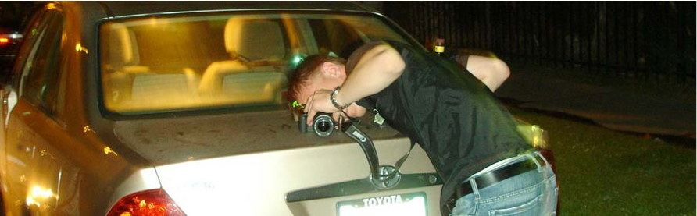

Camera Study:
With your stakeholder’s permission, record their routine, activities, behavior for a entire day or two for deeper study and understanding their problems or spot the opportunities.
Shadowing:
With your stakeholder’s permission, shadow/follow them to record everything about them to learn and understand their problems or spot the opportunities.
Collect data based on these tools and prepare & submit AEIOU (Observation) canvas given in next slide.
© 2020 Innodesk Designovation Services. All rights reserved.

Slide 12
A
activity
AEIOU Framework
(developed by Ethnohub)
Activities
Environments
Interactions
Objects
Users
U
users
E
environment
User
Experience
O
objects
I
interaction
The AEIOU framework was originated in 1991 at Doblin by Rick Robinson, Ilya Prokopoff, John Cain, and Julie Pokorny. It aim was to help analyse Ethnomethodology data and Conversation analysis with MECE categories.
(Source: http://help.ethnohub.com/guide/aeiou-framework)

Slide 13
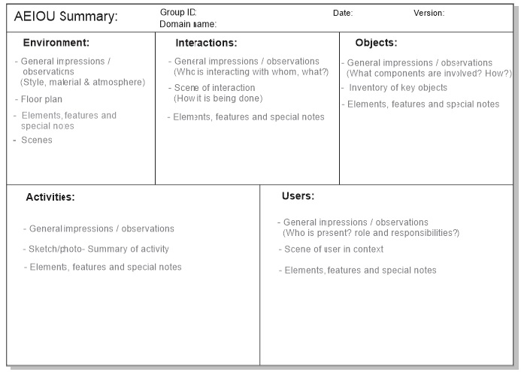

Slide 14

Without understanding - what people see, feel and experience;
Design & Innovation is a pointless task.
“Towards identifying the user’s unarticulated needs”
© 2020 Innodesk Designovation Services. All rights reserved.

Slide 15
Empathy Tools & Frameworks
5W & H: Create questionnaire for different stakeholders
Laddering (Multiple WHYs): for deeper interventions to find root cause
Persona
Customer Journey Map
Empathy Map
Problem Scenario → Problem Statement
© 2020 Innodesk Designovation Services. All rights reserved.

Slide 16
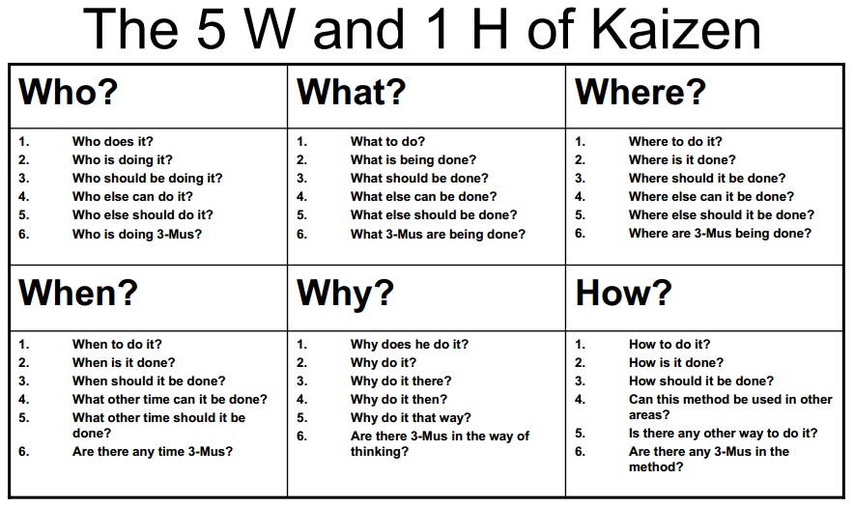
Select a stake holder & create questionnaire for him/her to find various problems/possibilities....You will get different problems/possibilities after interviewing various stakeholders through 5W & H tools.

Slide 17
Create 5W & 1H Questionnaire
Who? | What? | Where?
1. 2. 3. 4. 5. . . | 1. 2. 3. 4. 5. . . | 1. 2. 3. 4. 5 . .
When? | Why? | How?
1. 2. 3. 4. 5. . . | 1. 2. 3. 4. 5. . . | 1. 2. 3. 4. 5. . .

Slide 18
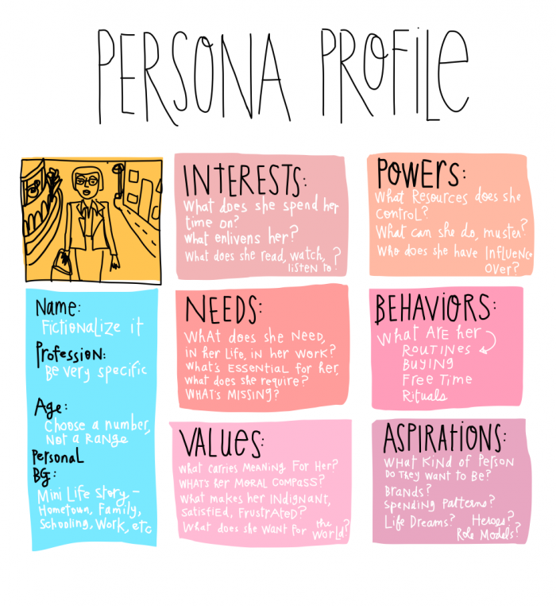
Persona

Slide 19
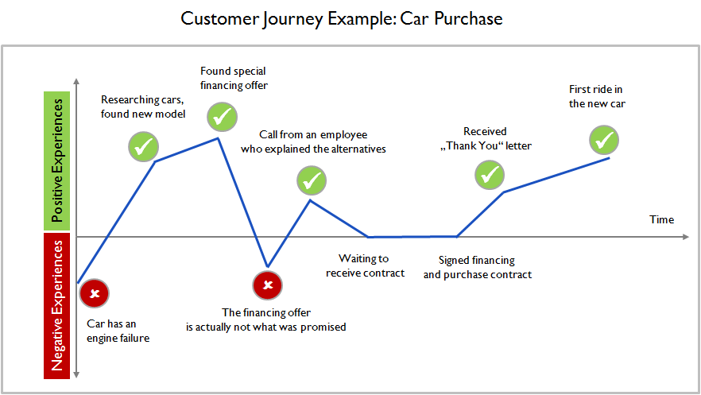
Customer Journey Map

Slide 20
Empathy mapping
Empathy Map helps:
To Empathize User
To Find Emotional/Unarticulated needs of user
Story Telling Through Identification of Happy/Excitement and Sad/Pain moments
Find out insights and problems/possibilities

Slide 21
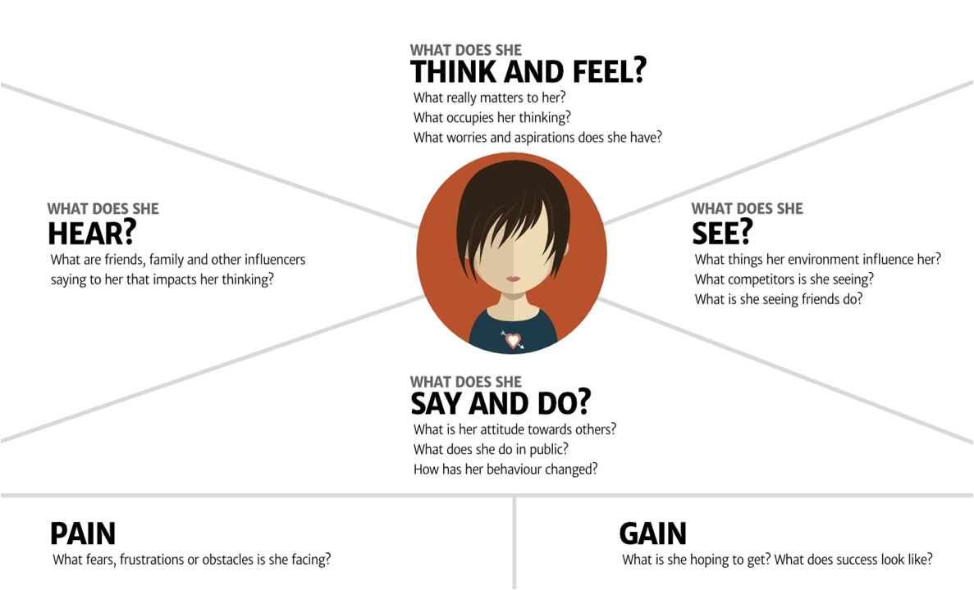

Slide 22
Problem Articulation
User/Stake holder
Problem/Need
Insights
needs a
way to
because
Example.
Persona
Need (Verb)
Insights
Laxman who is a middle aged man with low income
To be more aware of cheaper options for health treatment
He is worried of will he mange such expenses
needs a
way to
because

Slide 23
Field Work deliverables..
(Deadline – 23rd September, 2021)
Each team will have primary & secondary research and bring back..
Observation
Stake holder Mapping
Activities
Process-systems
Customer touch points
AEIOU Canvas (60 observations)
5 deep insights (pain/possibility)
Empathy
5W & H questionnaire
2 Persona
2 journey map
3 interview (video/telephonic)
5 deep insights from interview (pain/possibility)
Empathy Canvas

Slide 24
E - Workbook
Part 2
© 2020 Innodesk Designovation Services. All rights reserved.

Slide 25
I have an IDEA
What does it look like?
What problems/pain points do I solve?
How do I convert it into solution?
Do customers want it?
How do I get funding? How much?
Is it right for my business?
© 2020 Innodesk Designovation Services. All rights reserved.

Slide 26
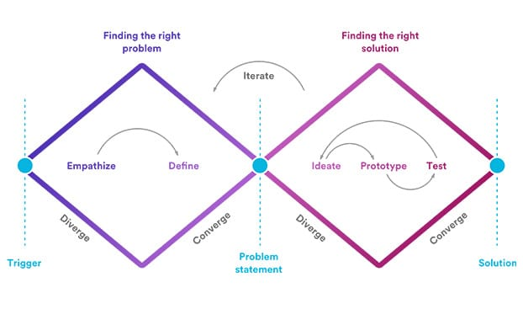
Ideation
Ideation
Ideation
The double-diamond process, initially introduced by The Design Council in 2005, and adapted by ICF International.

Slide 27
IDEATION is creative process of GENERATING IDEAS.
What is an IDEA? - Preliminary, Abstract, Piecemeal solution
Creativity is not gifted one, It is innate talent all of us have. It can be nurtured and developed with continuous practice.
Ideation is not about coming up with the right idea.
It’s about generating the broadest range of possibilities.
© 2020 Innodesk Designovation Services. All rights reserved.

Slide 28

What is Innovation?
A NEW IDEA IS A NOVEL COMBINATION OF EXISTING IDEAS.

Slide 29
1. OPEN MIND 2. SPONTENIETY 3. CURIOSITY 4. CO-CREATION 5. QUANTITY OVER QUALITY 6. JUDGEMENT FREE ENVIRONMENT 7. COMBINE & REFINE
Mindset for Creativity (Creative Thinking)
© 2020 Innodesk Designovation Services. All rights reserved.

Slide 30
What is Brainstorming?
Definition:
Brainstorming is a Creativity Technique by which efforts are made to find a conclusion for a specific problem by gathering a list of Ideas Spontaneously. (Source: Wikipedia)
The term was popularized by Alex Faickney Osborn in the 1953 in his book Applied Imagination.
© 2020 Innodesk Designovation Services. All rights reserved.

Slide 31
Ground rules for better brainstorming (Credit: IDEO)
Stay On TOPIC.
Allow ONE Conversation.
Go for QUANTITY.
HEADLINE!!! Be VISUAL!!!
Welcome WILD Ideas.
Defer JUDGMENT.
BUILD on Ideas of Others.
COMBINE & REFINE Ideas.

Slide 32
Let’s Brainstorm
Based on the problem(s) that you have defined in Problem Articulation phase (part 1), {You can use bigger chart paper or PPT or MIRO tool or wall to write down your ideas}
Think of all possible ideas/ways to solve that problem(s).
First come up with the list of ideas individually, then discuss those ideas with your team members to combine, refine and create some more ideas
Be creative and optimistic in generating as crazy ideas as possible
No idea is too small/big or right/wrong in this phase
Develop more ideas on ideas of others
During this divergent phase, don’t make any judgement, select or discard the ideas initially.
Quantity is more important than quality at this initial stage of Ideation.
© 2020 Innodesk Designovation Services. All rights reserved.

Slide 33
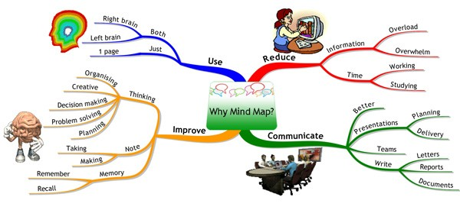
Mind Mapping
“A mind map is a visual representation of hierarchical information that includes a central idea surrounded by connected branches of associated topics.”
© 2020 Innodesk Designovation Services. All rights reserved.

Slide 34
Create Mind-map
Based on the ideas that you and your team has created during Brainstorming, prepare a mind map by representing those ideas visually.
Discuss all ideas in team through deleting some not useful and less important ideas, then combine, refine and group them into various categories/buckets.
Then, arrange these groups describing it with central theme/concept/idea (here central theme will be your domain/problem) to which rest of the map revolves around.
From that main idea, create branches (as many as needed) which represent ideas that you created during brainstorming.
It’s helpful to use different colours and images to differentiate the branches and sub-topics.
After representing all ideas created during Brainstorming session, through various branches of Mind-map, now create sub-branches (new ideas through Mind-Map) that stem from the main branches to further expand on ideas and concepts.
This helps to further develop and create more and more ideas to come up with the innovation and create quantities of ideas.
© 2020 Innodesk Designovation Services. All rights reserved.

Slide 35
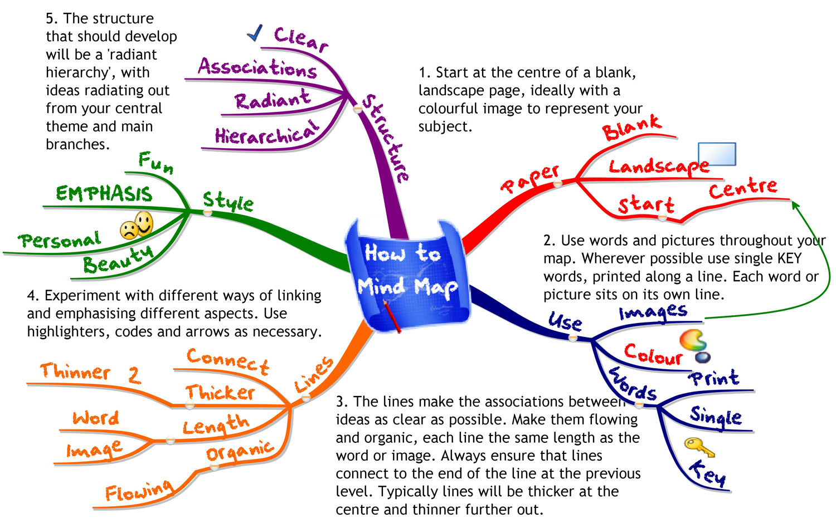

Slide 36
Divergent Thinking
Divergent Thinking is thinking many ideas or many ways of finding solutions rather than coming up with only 2-3 solutions.
It is horizontal thinking technique where the quantity of ideas is more important initially than quality
Let’s Use Randomization (Connecting random/unconnected ideas/solutions from different domain) to generate ideas for solving problem(s).
© 2020 Innodesk Designovation Services. All rights reserved.

Slide 37
Lateral Thinking
Lateral Thinking is also called as Out of the Box thinking.
The process of challenging your own assumptions about the problem you’re facing.
The thing that distinguishes this problem-solving method from the rest of the bunch is that you’re encouraged to change the way you look at the problem.
Lateral Thinking is an indirect and creative approach, typically through viewing the problem in a new and unusual way.
© 2020 Innodesk Designovation Services. All rights reserved.

Slide 38
SCAMPER
Use the SCAMPER tool and create/refine ideas further.
S – SUBSTITUTE – What elements of this product/service can be substituted?
C – COMBINE – How can this product/service be combined with other products/services?
A – ADAPT – What idea from elsewhere can be altered or adapted?
M – MODIFY/MAGNIFY – Can any component be greatly enlarged or greatly reduced?
P – PURPOSE – What completely different purpose can the product/service have?
E – ELIMINATE – What elements of the product/service can be eliminated?
R – REVERSE/REARANGE – How can the product/service be rearranged / can the process be reversed?
© 2020 Innodesk Designovation Services. All rights reserved.

Slide 39
Deliverables at the end of IDEATION Phase...
Each team will have to create minimum 40 Ideas using above tools & Techniques.
Mention ideas under each tools you used to create them.
Collect, Refine, Develop Ideas based on group discussion.
You can use bigger chart paper or PPT or MIRO tool or wall to write down your ideas.
© 2020 Innodesk Designovation Services. All rights reserved.

Slide 40
Conceptualization
What should the CONCEPT ACHIEVE?
It should be able TO SOLVE THE PROBLEM with relevance to the context and add value.
Other practical aspects including USABILITY, FEASIBILITY, SCALABILITY and BUSINESS MODEL will follow later on.
After Ideation (Divergent) phase - you have successfully generated lots of ideas, then you collected, categorized, refined couple of them – now select (converge) them using conceptualization tools mentioned further to transform those rough ideas into something actionable (possible solutions) to prototype & test further.
© 2020 Innodesk Designovation Services. All rights reserved.

Slide 41
Conceptualization
Design/Innovation is largely depends on the constraints/restrictions of your domain.
For Example, Constraints like Cost/Budget, Time, Quality, Technology, Processes & Operations, Performance, Usability, Integration/ Compatibility, Efficiency, Compliances, Environment, Material, Logistics, Safety, Ethics etc.
Screen the ideas through constraints of your domain. Each domain has separate constraints.
Then screen/analyze/select the ideas based on below factors -
Technical feasibility, Market opportunity (Competition), Aesthetic and Ergonomics, Business or cost restrictions, Quality and Reliability, Value Creation, Execution, Scalability
Keep In Mind -
Don’t narrow too fast – it’s a gradual process
Don’t immediately worry about feasibility or scalability
Discuss about the ideas to which team is very excited, surprised or curious
© 2020 Innodesk Designovation Services. All rights reserved.

Slide 42
PESTLE Analysis
Is a tool used to analyse and monitor the macro (external) factors that may have a profound impact on an organisation’s performance. This tool is especially useful when starting a new business or entering a foreign market.
Political
Economical
Social
Technological
Legal
Environmental
Stability of Government
Potential Legislation Changes
Global Influences
Economic Growth
Employment Rates
Inflation Rates
Budget policy
Consumer buying capacity
Demographic influences
Lifestyle factors
Income distribution
Population growth
Social Stigma
Technological Changes (R&D)
Technological Comm.
Emerging Tech
Feasibility & Viability
Automation
Taxation policies
Employment laws
Industry regulations
Health & Safety
Regulations & Restrictions
Customer behaviors
Global trends
Sustainability
© 2020 Innodesk Designovation Services. All rights reserved.
Notes:
It gives a bird’s eye view of the whole environment from many different angles that one wants to check and keep a track of while contemplating a certain idea/plan.

Slide 43
Opportunities and Challenges to pursue KPIs (Basic SWOT analysis)
Strength
Things that your company do well
Weakness
Things your company lacks
Opportunity
Identify Gaps from Market
Threat
No strong entry barrier
Differentiation Qualities
Internal Resources
Few Competitions in your domain
Tangible assets
Things your competitor do better than you
Resource Limitation
Unclear USP
Emerging needs for your solution
Press/Media coverage
Changing Regulatory environment
Negative feedback/review, press/media coverage
Changing Customer interest in your solution
© 2020 Innodesk Designovation Services. All rights reserved.

Slide 44
NEXT MAKING IDEAS HAPPEN…..
Thinker + Maker = Innovator
( 10 % )
( 90 % )
COMING UP WITH AN IDEA IS ONLY HALF OF THE STORY……
if thinking is 10 % then, implementing ideas into useful, marketable solutions is 90 % efforts, where role of the Innovator/Entrepreneur is very crucial by putting persistent and iterative efforts.
© 2020 Innodesk Designovation Services. All rights reserved.

Slide 45
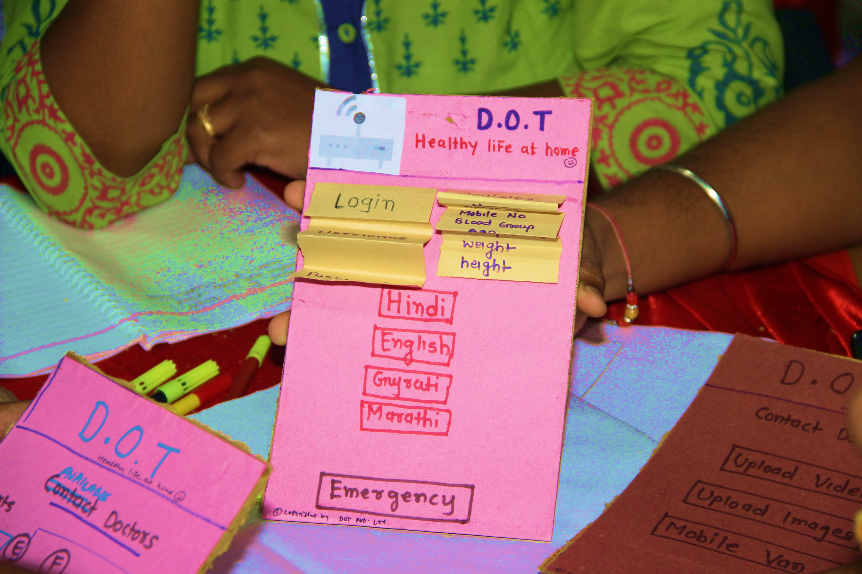
PROTOTYPE: Design Thinking
© 2020 Innodesk Designovation Services. All rights reserved.

Slide 46
What is Prototype?
A prototype is a simple experimental model of a proposed solution used to test or validate ideas, design assumptions and other aspects of its conceptualisation quickly and cheaply, so that the designer/s involved can make appropriate refinements or possible changes in direction.
© 2020 Innodesk Designovation Services. All rights reserved.

Slide 47
WHY Prototype?
Building prototypes means
making ideas tangible,
learning while building them and
sharing them with other people.
Even with early and rough prototypes, you can receive a direct
response and learn how to further improve and refine an idea
Whereby saving time & money.
© 2020 Innodesk Designovation Services. All rights reserved.

Slide 48
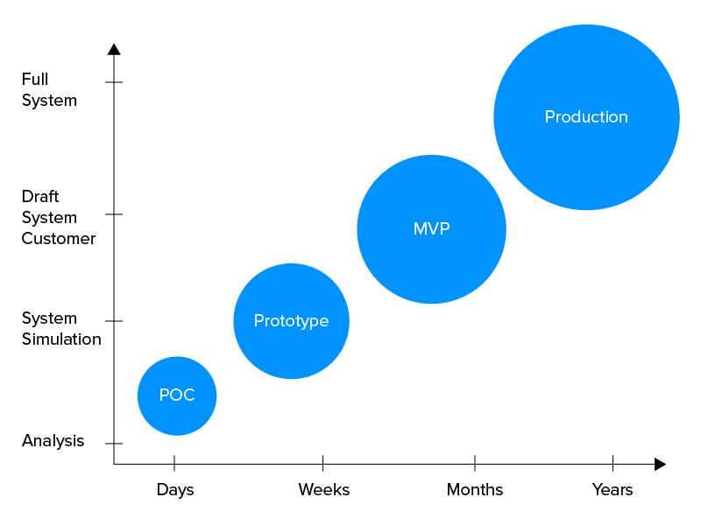
Types of Prototype?

Slide 49
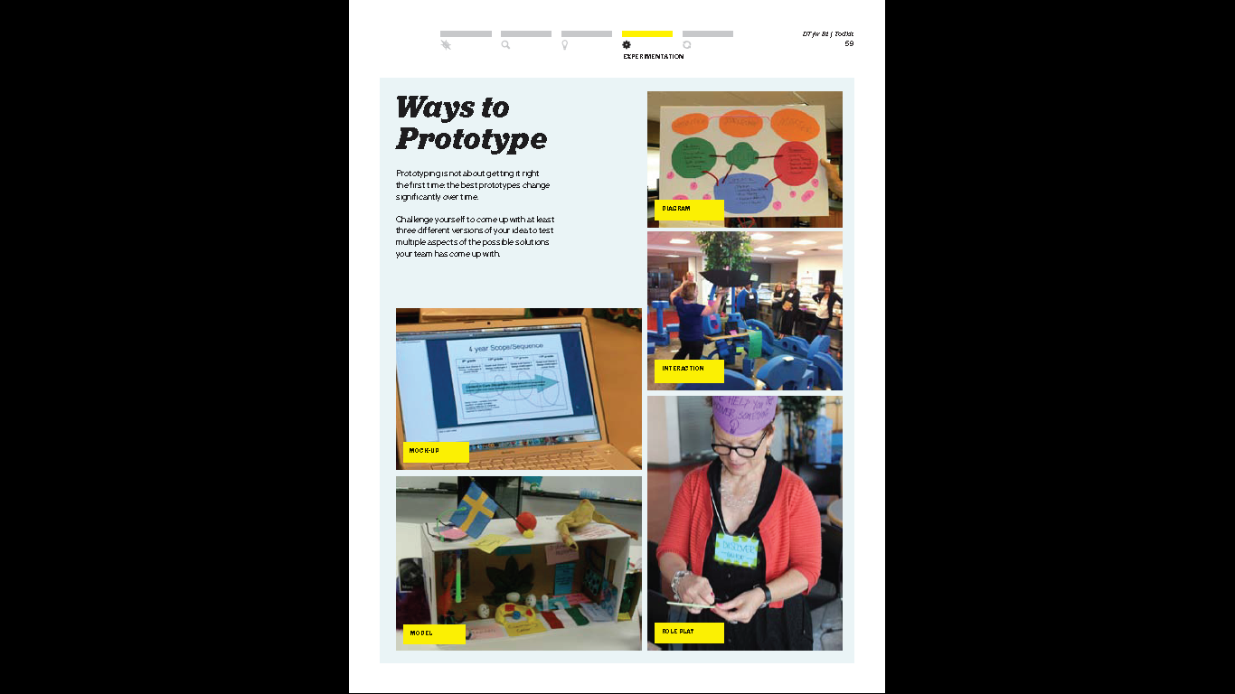
Diagram
Interaction
Model
Role Play/Drama
Story board
Mock up
3D Printing

Slide 50
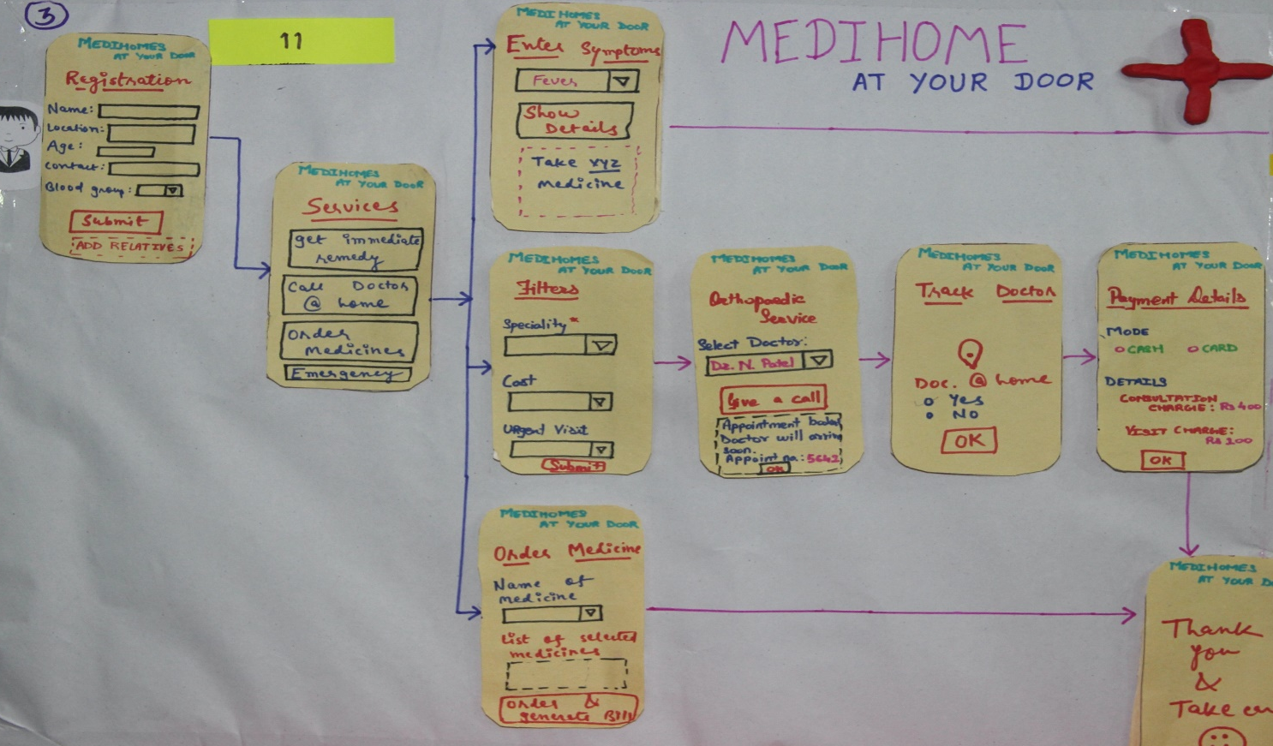
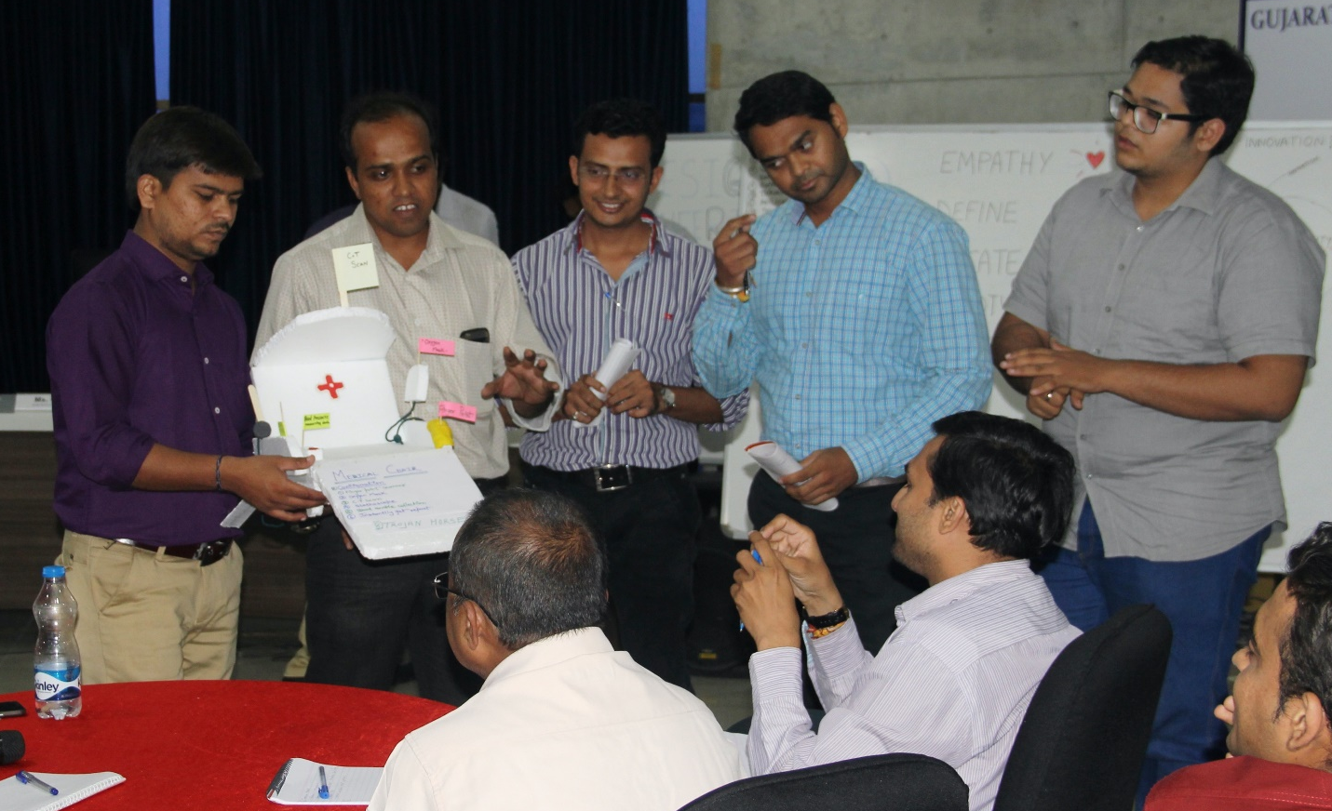
Examples of Prototype
Diagram
Interaction
© 2020 Innodesk Designovation Services. All rights reserved.

Slide 51
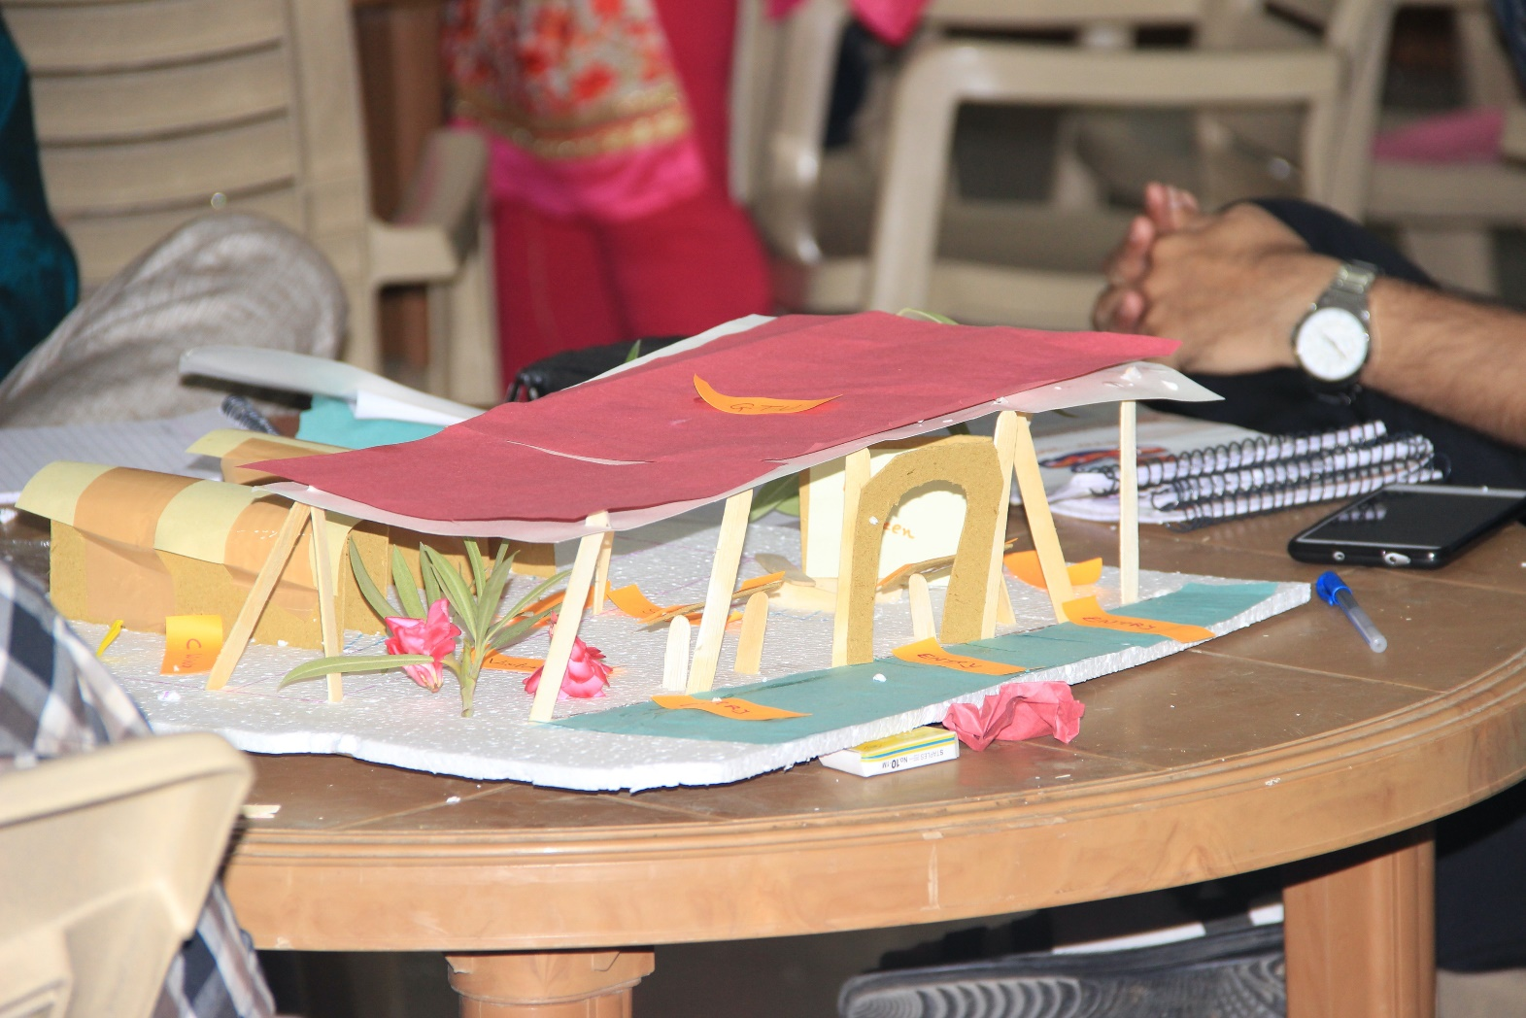
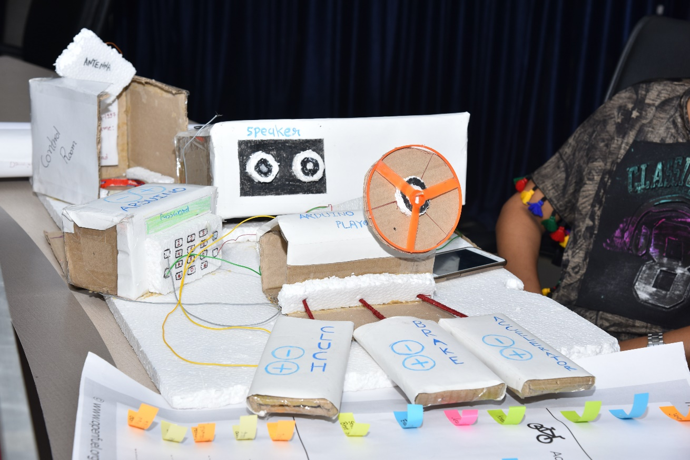
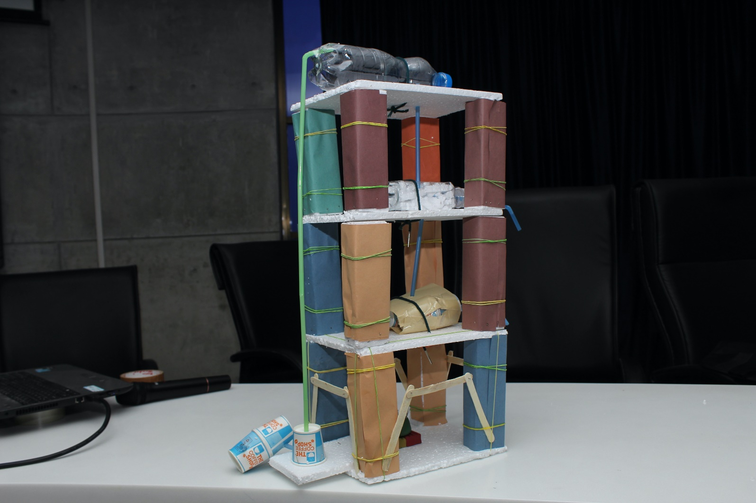
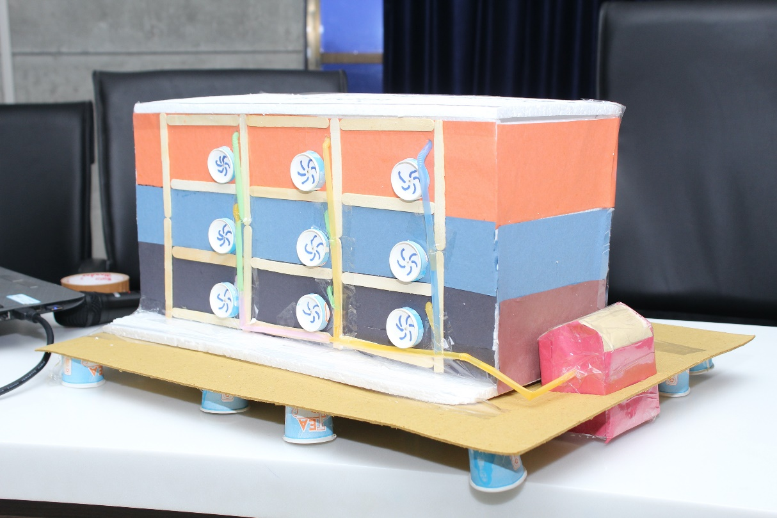
Examples of Prototype
Model
© 2020 Innodesk Designovation Services. All rights reserved.

Slide 52
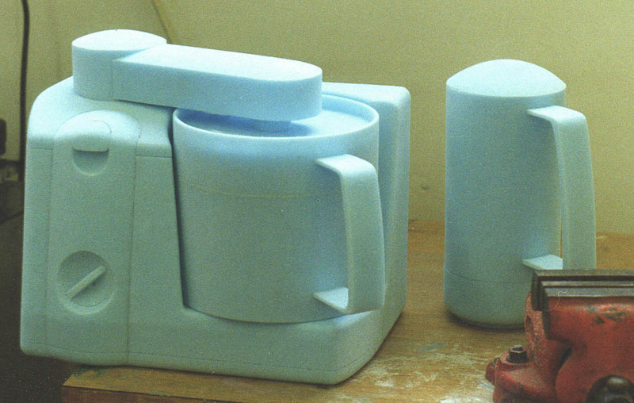
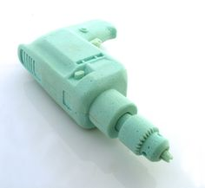
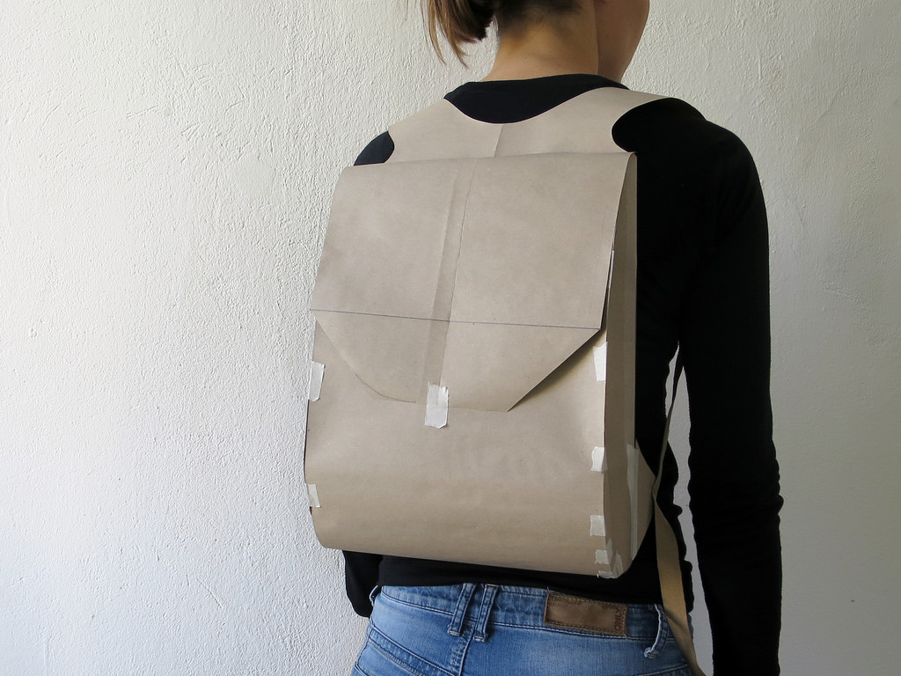
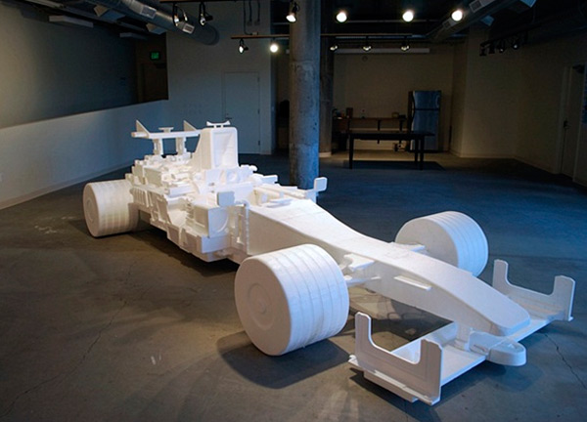
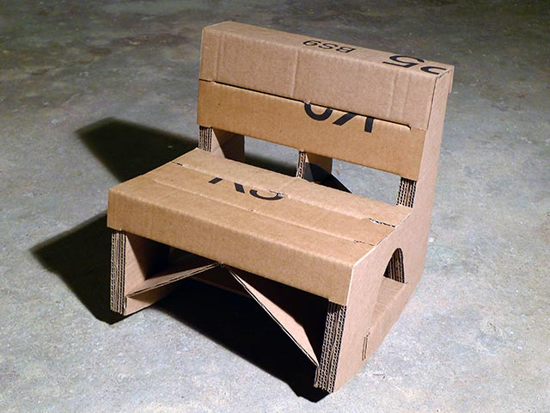
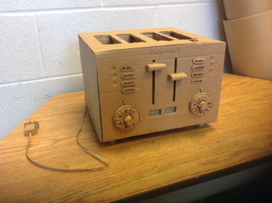

Slide 53
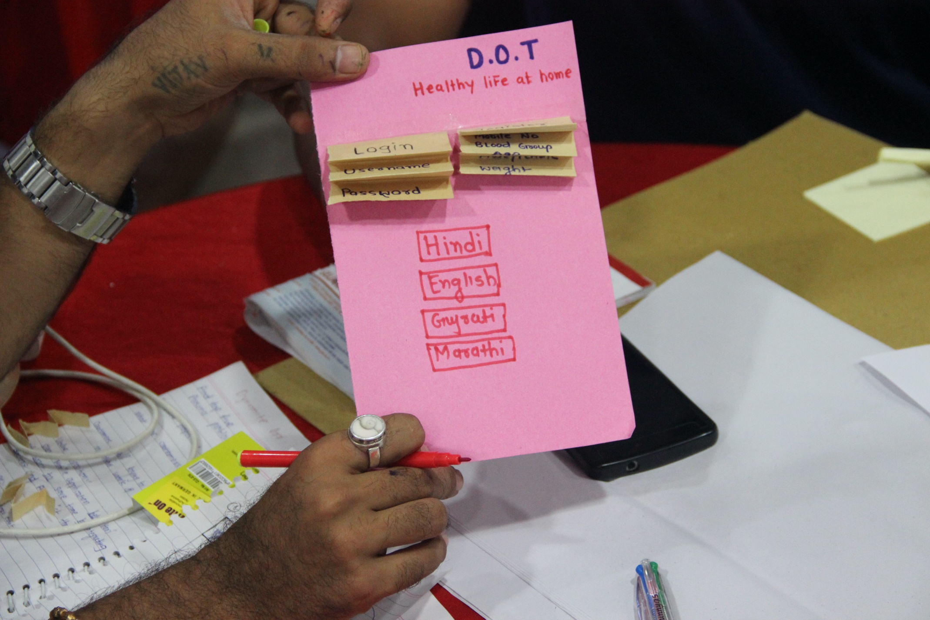
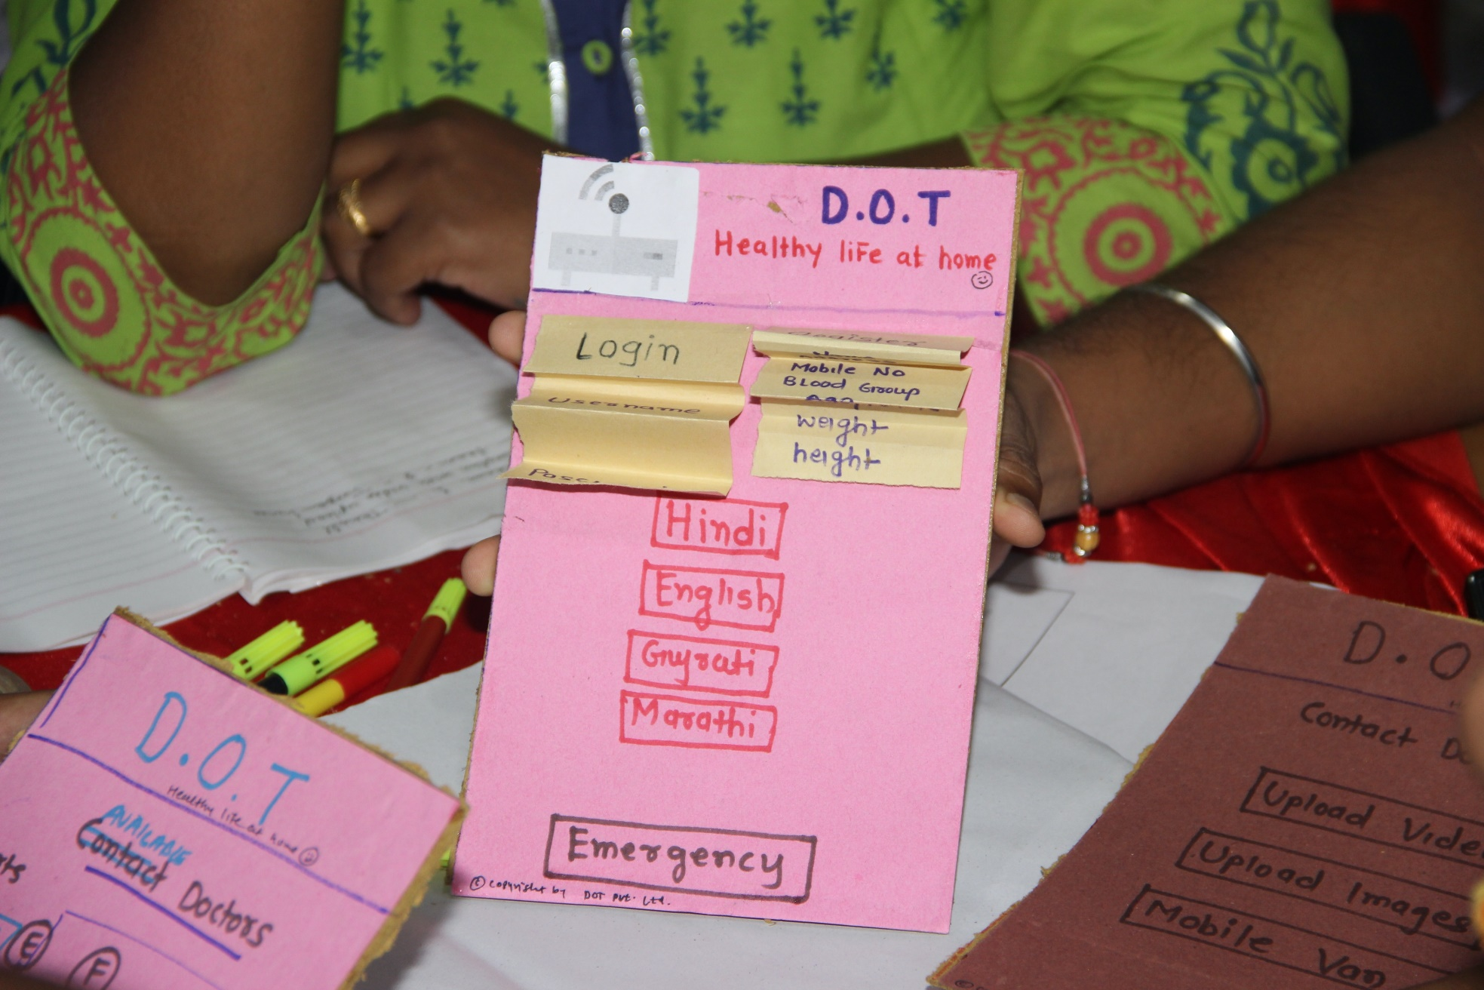
Prototype for Mobile App
© 2020 Innodesk Designovation Services. All rights reserved.

Slide 54
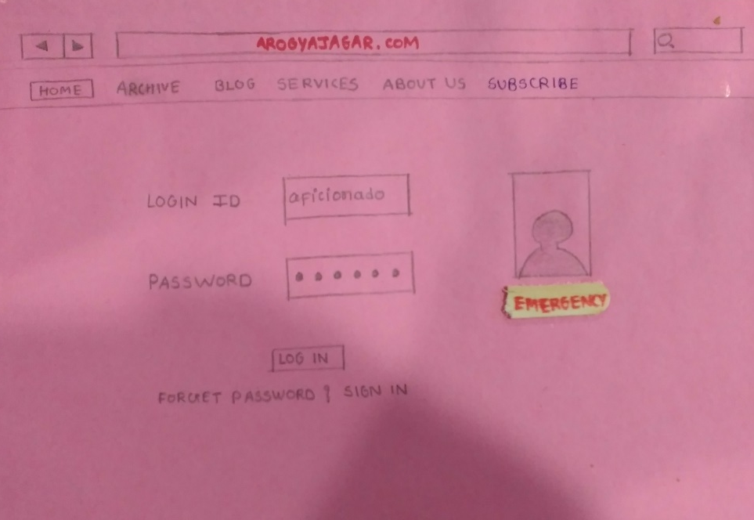
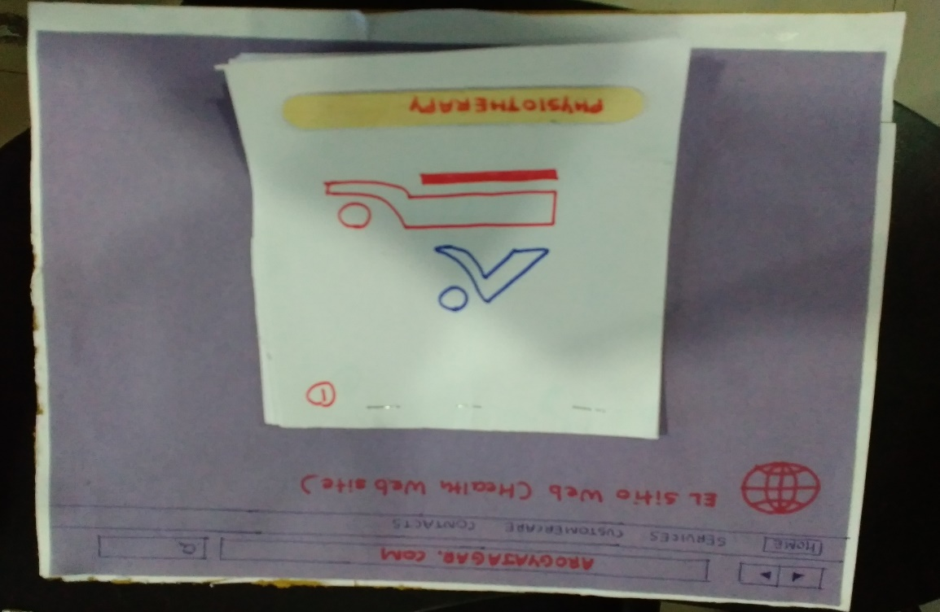
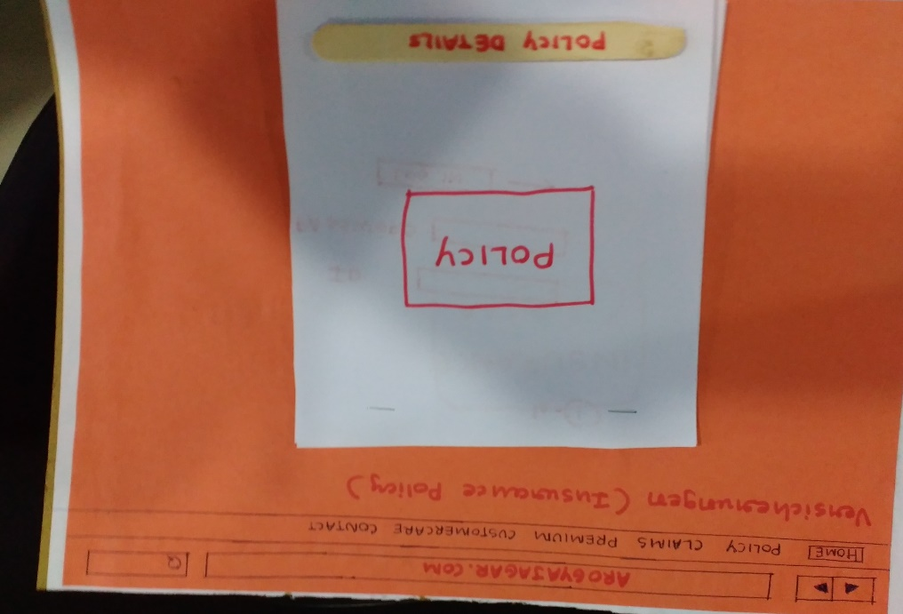
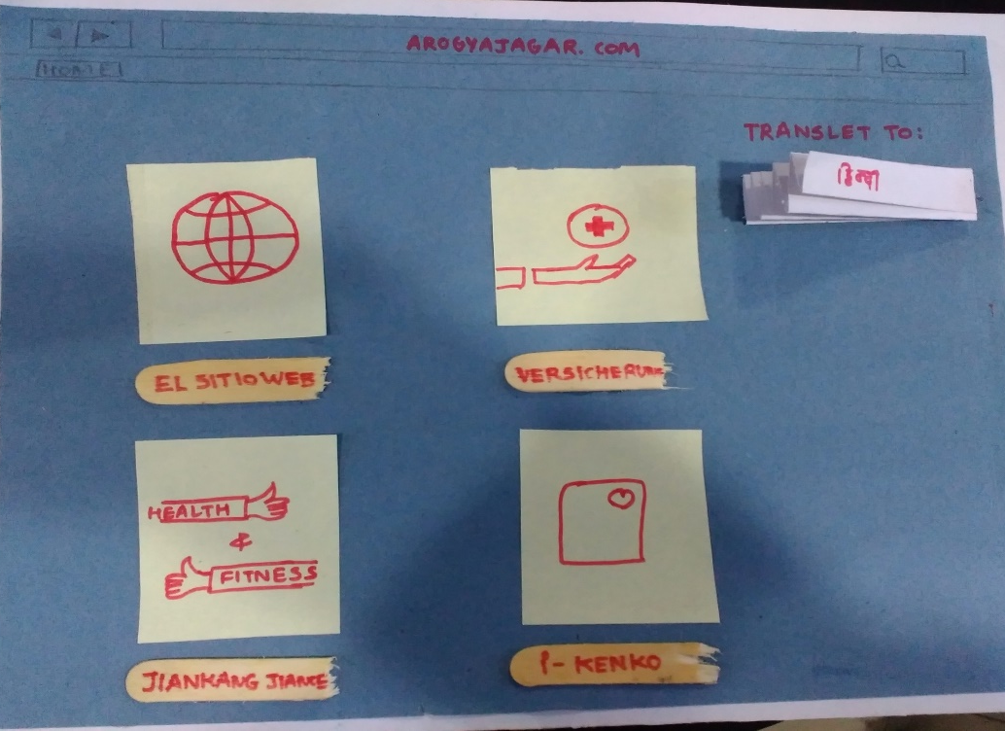
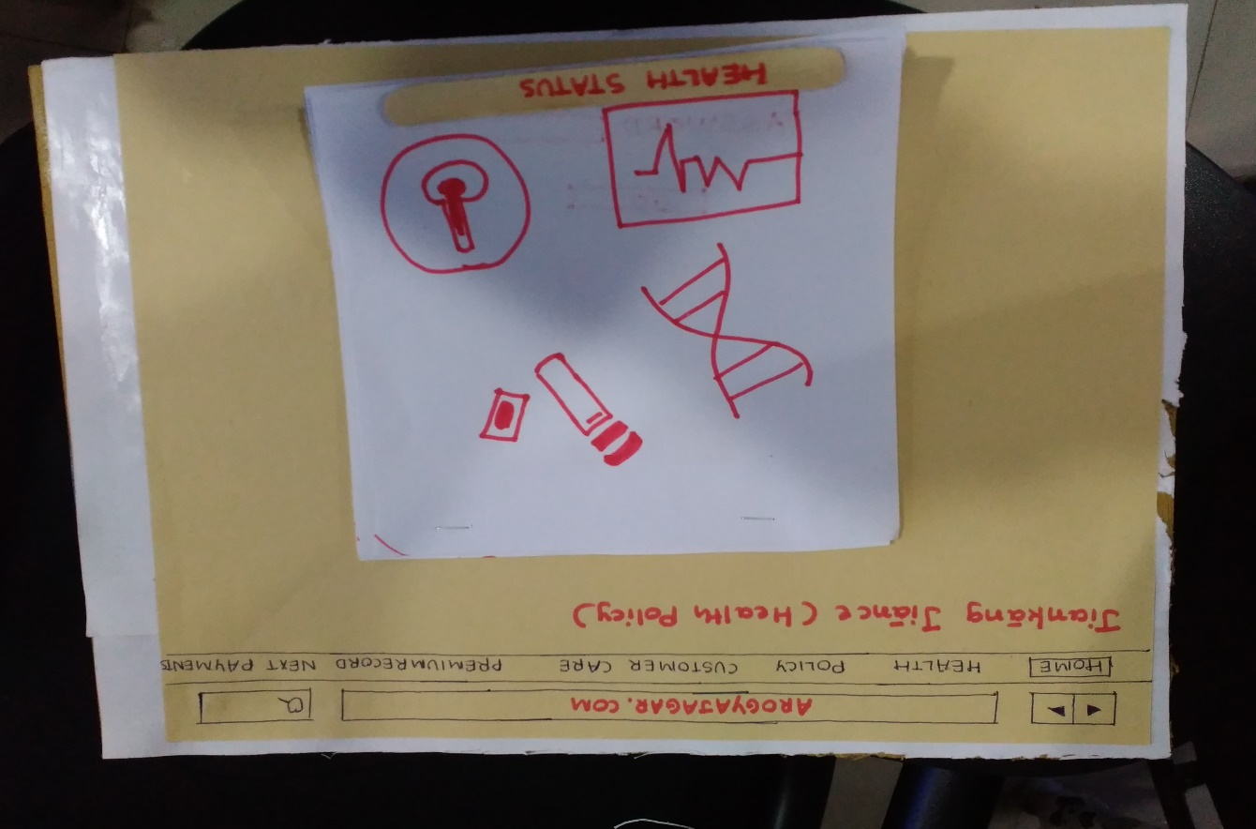
Prototype for Mobile App
© 2020 Innodesk Designovation Services. All rights reserved.

Slide 55
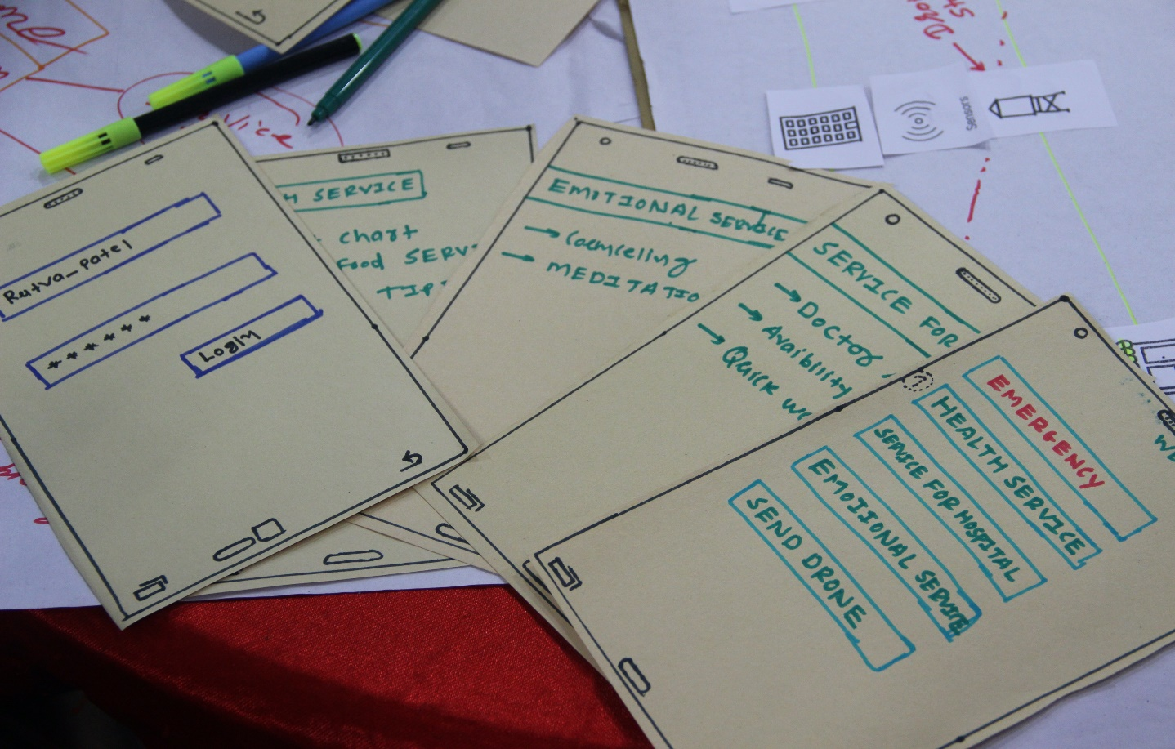
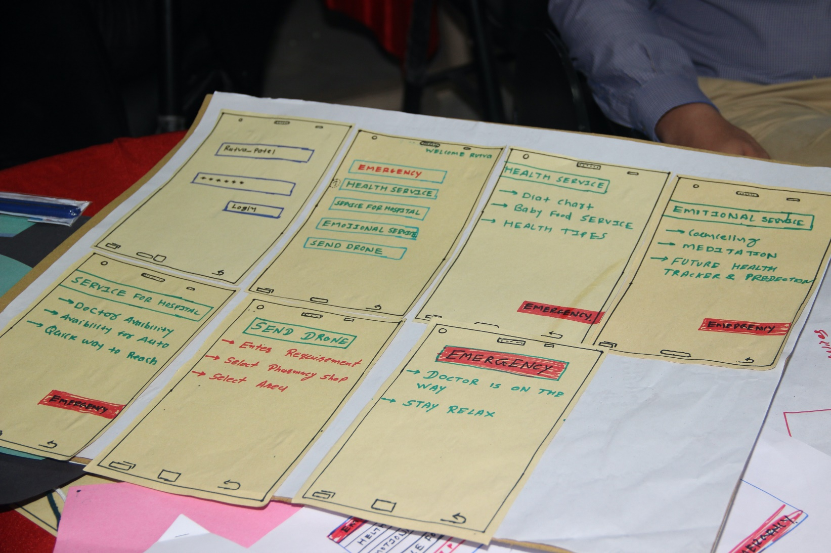
Prototype for Mobile App
© 2020 Innodesk Designovation Services. All rights reserved.

Slide 56
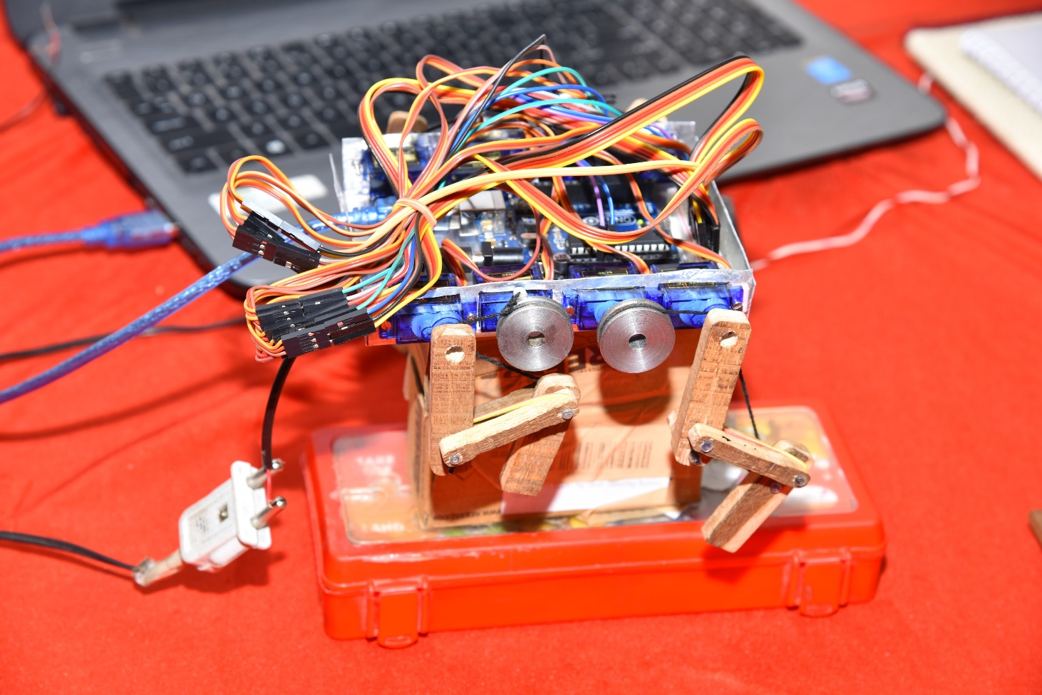
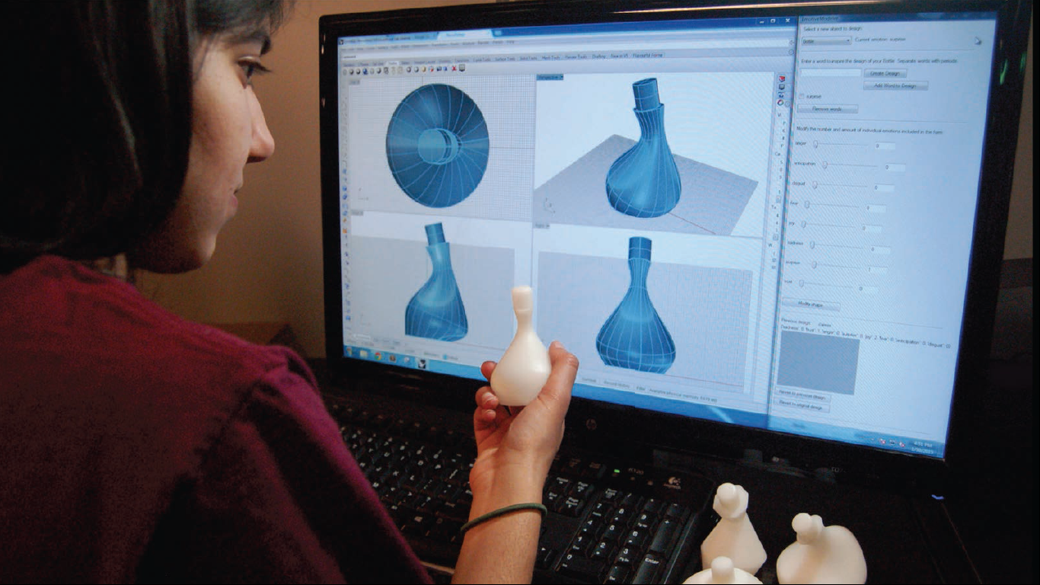
Other Prototypes Ways
© 2020 Innodesk Designovation Services. All rights reserved.

Slide 57
Prototype descriptions and Photographs
Prototype
Version 1
Prototype
Version 2
Prototype
Version 3
Prototype
Version 4
You may add as many version of Prototype as you want here.

Slide 58
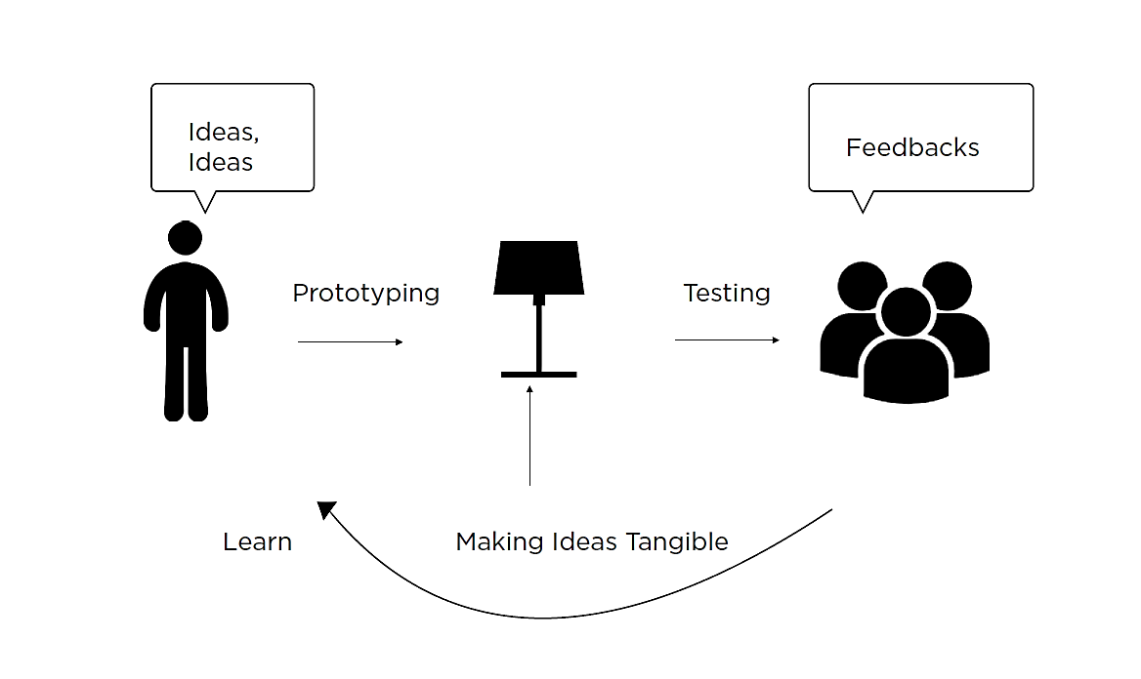

Slide 59
Test
Assign Roles within you team.
Show your prototype, Don’t explain or talk about it!
Feedback is a gift and not a critique.
Refine your solutions as per feedback and needs of user.
‘failure’ just means you need to change something.

Slide 60
Feedback Capture Grid
Likes
Criticisms
Questions
Ideas/Suggestions
© 2020 Innodesk Designovation Services. All rights reserved.

Slide 61
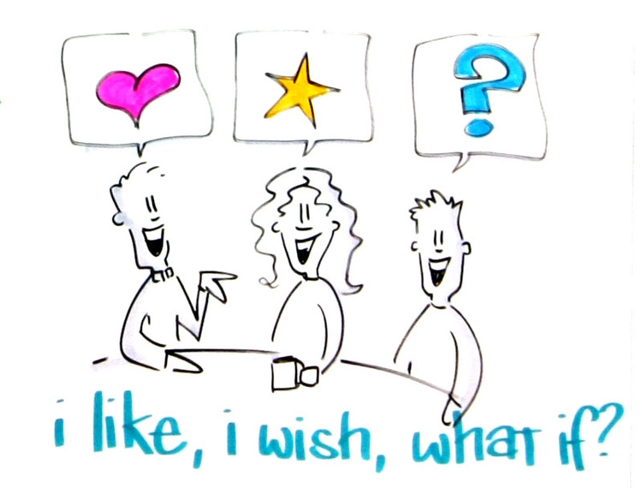

Slide 62
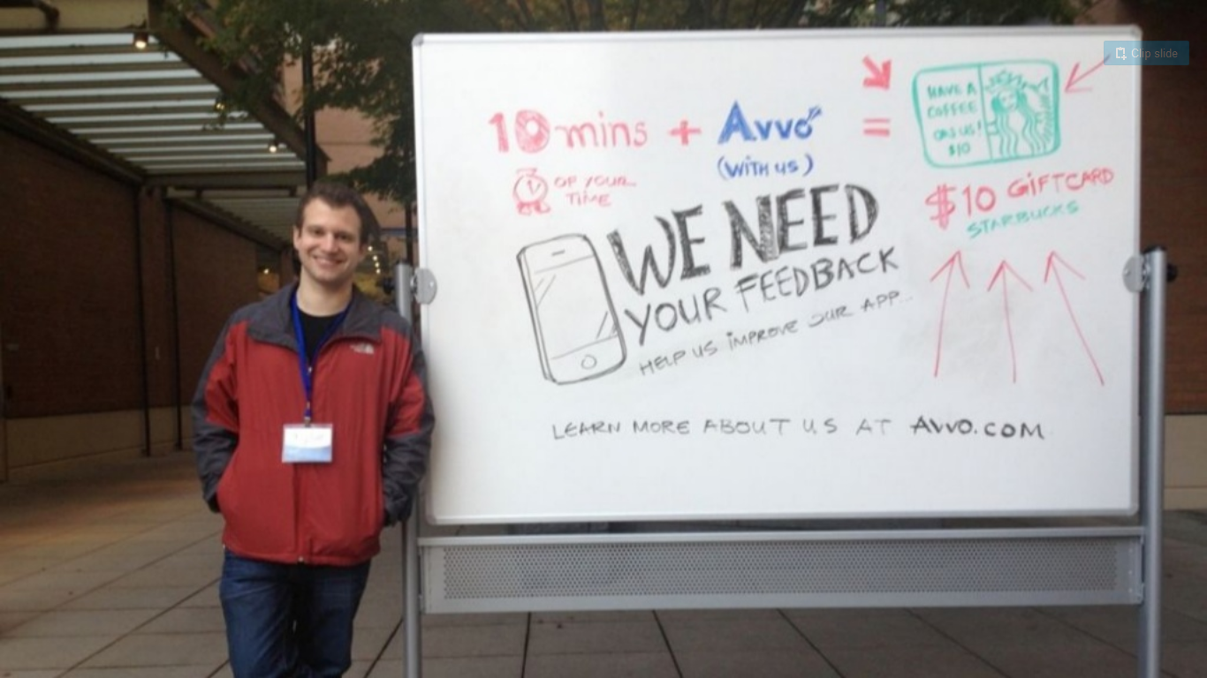

Slide 63
Feedback and Iterations of Prototype
Mentioned the feedbacks that you received from users and stakeholders for each versions of your prototype.
Based on feedbacks, refine and iterate your solutions to further build next version of your prototype.
Iteration 1
Iteration 2
You may add as many iterations of Prototype as you want here.

Slide 64
Deliverables at the end of Conceptualization, Prototype, Test Phase...
Each team will have to refine, combine and finalize on various ideas from Ideation phase to prototype 2-3 concepts.
Create prototype of probable 2-3 concepts and test with your users and stakeholders. Then combine best features of these concepts into final solution.
Based on their feedback, make little refinement and iterate the prototypes and build it again.
Repeat the above steps of build-test-iterate till you get final solutions.
© 2020 Innodesk Designovation Services. All rights reserved.

Slide 65
What is Business Model?
An enterprise's plan to create, operate and sustain a business
A plan for the successful operation of a business, identifying various key resources, activities, who are your customer and how do you reach them, financial and revenue model etc.
“How an enterprise create, deliver and capture Value”

Slide 66
Types of Business Models
Subscription Model - Netflix, Hulu, Amazon Prime, Disney+
Bundling Model - Adobe Creative Suite, Microsoft Office, Burger King
Freemium Model - Spotify, LinkedIn, Skype, MailChimp
Razor Blades Model – Gillette, HP & Canon printers, Xbox
Product to Service Model - Zipcar, Uber, Zometo, Lyft
Leasing Model - U-Haul, Enterprise, Rent-a-Center
Crowdsourcing Model - Wikipedia, YouTube, IMDB
One-for-One Model – Social Entrepreneurship
Blake Mycoskie, the founder of TOMS, pioneered this form of social entrepreneurship.
Franchise Model - Starbucks, Domino’s, Subway, McDonald’s

Slide 67
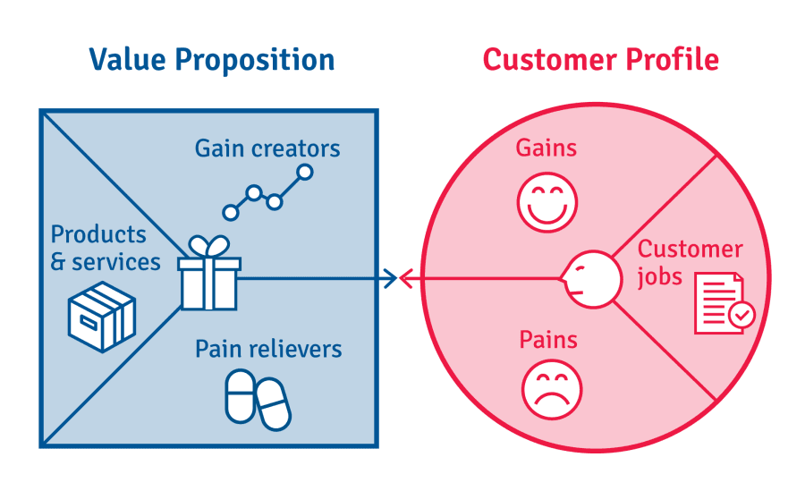
FIT
Create a Value Proposition for your project. You already created Customer Profile during Part 1 (Observation, Empathy, Define) and also Value Proposition (Innovation) during Part 2 {Ideation, Conceptualization, Prototype, Test}. Now find the fit between these two to create your Value Proposition.

Slide 69
9 Building blocks of BMC
Customer segments: List down the customer segments for whom we are creating the value, whose problem we are solving. Look for the segments that provide the most revenue by customer segmentation.
Value proposition: what are your products and services and what value we are providing to our customers? How are we solving their pains/problems? What is the job you get done for your customer? Which customer needs we are satisfying? - Try to create 1-2 values but do it extremely well to create your USP.
Channels: How do you communicate and reach your customer? How do you deliver the value proposition? What is the cost of channels?
Customer relationships: How do you acquire customers, build strong relationships and retain them to sustain your business? What aspirations of customers are we trying to satisfy to build healthy relationships?
Key activities: What do you do every day to run your business? Operational processes, creating and making the products, sales and marketing, software or digital platform development etc.
Key resources: The key resources include HR (people), Intellectual (knowledge), Physical (means), and Financial (money) that you need to run your business.
Key partners: List the partners that you can’t do business without. List of all stakeholders needed to run a business.
Cost structure: List your top costs by looking at activities and resources.
Revenue streams: List down the revenue streams and how you generate the same. If you do things for free, add them here too.
© 2020 Innodesk Designovation Services. All rights reserved.

Slide 70
Deliverables at the end of VPC & BMC phase...
(Deadline – 10th November, 2021)
Create a Value Proposition Canvas (VPC) and Business Model Canvas (BMC) for your project idea.
© 2020 Innodesk Designovation Services. All rights reserved.

Slide 71






Thank you
innodesk1@gmail.com
91 - 909 909 0464
Follow us on:
/innodeskzone

